Slide 1
Introduction to Xamarin.Forms
http://bit.ly/IntroXF

Slide 2


Sean Sparkman
Father, Husband, President of DFW Mobile .NET User Group, Xamarin MVP, Microsoft MVP, and Team Lead and Senior Developer at @IInteractive
Email: sean.sparkman@iinteractive.com
Twitter: @seansparkman

Slide 3
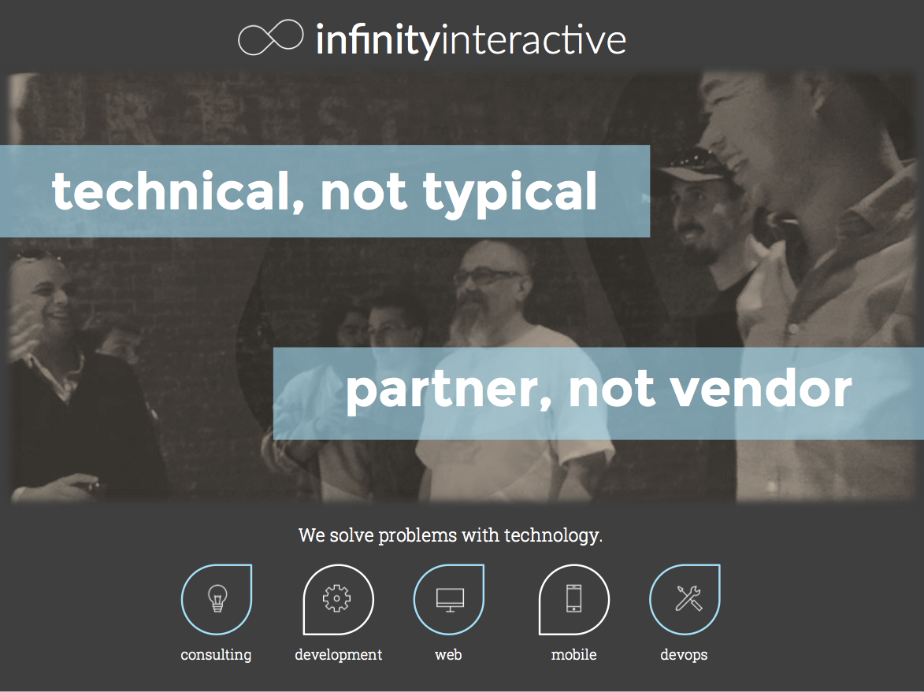

Slide 4

When: Third Wednesday of the Month
Time: 6:30 PM
Where: Improving Enterprises
5445 Legacy Dr.
Suite 100
Plano, TX
http://www.dfwmobile.net
@DFWMobileNet

Slide 5
Silo Approach
iOS
Android
Windows
Objective-C
Xcode
Java
Android Studio
C#
Visual Studio
No shared code • Many languages & development environments • Multiple teams
Notes:
Multiple Teams
Multiple Code Bases
Expensive & Slow
Positive = Great apps delivered to user’s platform
Negative = Development hampered by multiple code bases & fragmentation

Slide 6
Write Once, Run Anywhere
Lua
Javascript
Actionscript
HTML+CSS
App Generator
Limited native API access • Slow performance • Poor user experience
Notes:
Unhappy Users
Unhappy Developers
Increase in Abandoned Apps
Limited to what is implemented

Slide 7
Xamarin’s Unique Approach
iOS C# UI
Android C# UI
Windows C# UI
Shared C# Mobile
Shared C# codebase • 100% native API access • High performance

Slide 8
Windows APIs
Microsoft.Phone
Microsoft.Networking
Windows.Storage
Windows.Foundation
Microsoft.Devices
System.Net
System
System.IO
System.Linq
System.Xml
System.Data
System.Windows
System.Numerics
System.Core
System.ServiceModel

Slide 9
iOS – 100% API Coverage
MapKit
UIKit
iBeacon
CoreGraphics
CoreMotion
System.Net
System
System.IO
System.Linq
System.Xml
System.Data
System.Windows
System.Numerics
System.Core
System.ServiceModel

Slide 10
Android – 100% API Coverage
Text-to-speech
ActionBar
Printing Framework
Renderscript
NFC
System.Net
System
System.IO
System.Linq
System.Xml
System.Data
System.Windows
System.Numerics
System.Core
System.ServiceModel

Slide 11
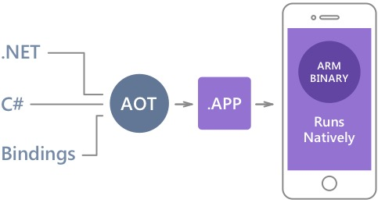
Native Performance
Xamarin.iOS does full Ahead Of Time (AOT) compilation to produce an ARM binary for Apple’s App Store.
Xamarin.Android takes advantage of Just In Time (JIT) compilation on the Android device.

Slide 12
Meet Xamarin.Forms
Build native UIs for iOS, Android, and Windows
from a single, shared C# codebase.

Slide 13
Xamarin Forms Platforms

Slide 14

Xamarin + Xamarin.Forms
iOS C# UI
Android C# UI
Windows C# UI
Shared UI Code
Shared C# Backend
Shared C# Backend
Traditional Xamarin Approach
With Xamarin.Forms: More code-sharing, all native

Slide 15
What’s included
✓ 40+ Pages, layouts, and controls
(Build from code behind or XAML)
✓ Two-way data binding
✓ Navigation
✓ Animation API
✓ Dependency Service
✓ Messaging Center
Shared UI Code
Shared C# Backend

Slide 16

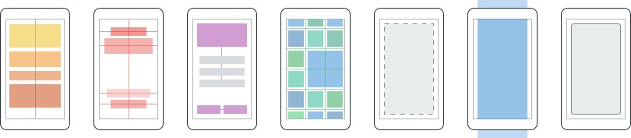
Layouts
Pages
Content
MasterDetail
Navigation
Tabbed
Carousel
Stack
Absolute
Relative
Grid
ContentView
ScrollView
Frame
Notes:
Inside of a page are layouts
A lot of options from something simple like a stack panel to complex and powerful grids

Slide 17
Controls
ActivityIndicator
BoxView
Button
DatePicker
Editor
Entry
Image
Label
ListView
Map
OpenGLView
Picker
ProgressBar
SearchBar
Slider
Stepper
TableView
TimePicker
WebView
EntryCell
ImageCell
SwitchCell
TextCell
ViewCell
Notes:
You have more than 40 controls, layouts, and pages to mix and match from.
These are all of the controls you have out of the box, you can of course create your own.
What is unique is you get the native control and have access to it.
Consider an Entry Field
On iOS it is mapped to UITextField
Android it is EditText
Windows Phoen it is a TextBox

Slide 18

80+ Live, online classes
1:1 Office Hour sessions with experts
Self-Guided Learning (free!)
Guest Lectures by industry luminaries
Check it out at xamarin.com/university

Slide 19
Thank You! Questions?
Sean Sparkman
Xamarin MVP / Team Lead / Senior Programmer
sean.sparkman@gmail.com
@seansparkman

